Slide 1

Rajeev Gupta
Trainer & Consultant

Slide 2

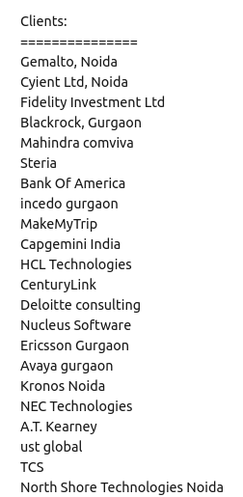
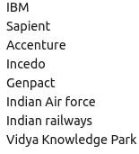

Slide 3
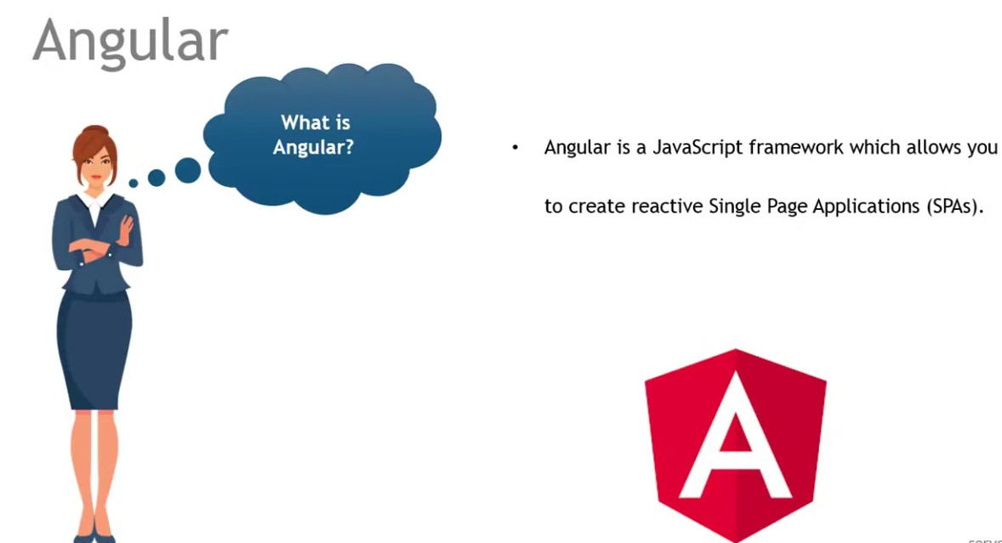
What is Angular?

Slide 4
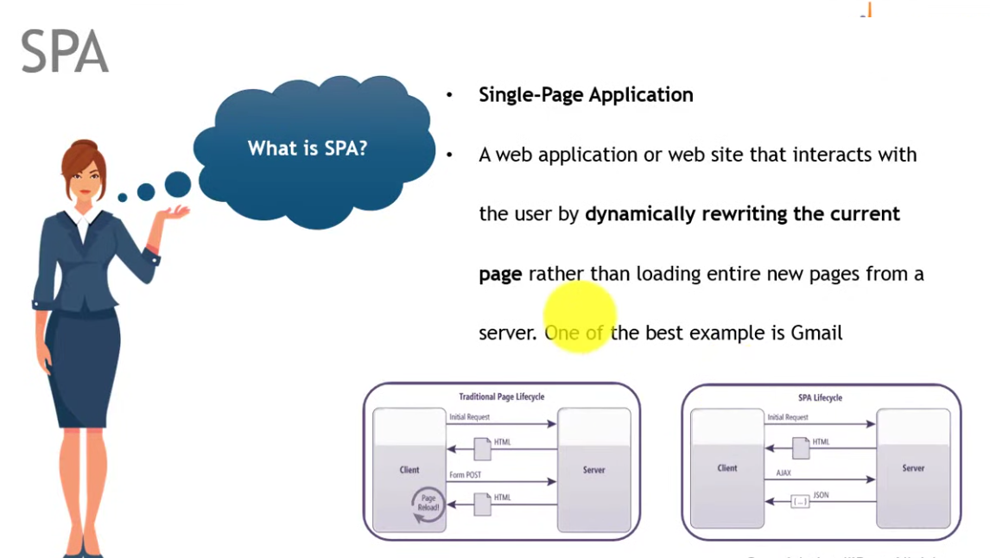
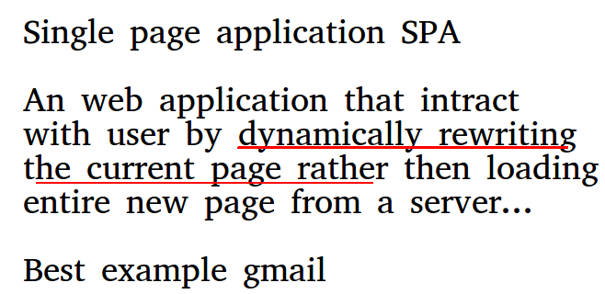
SPA

Slide 5
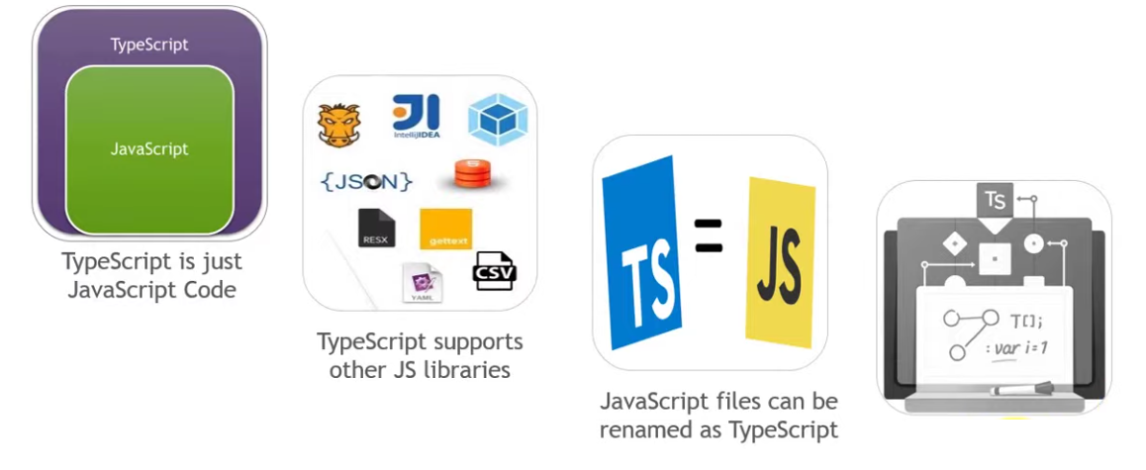
TypeScript

Slide 6
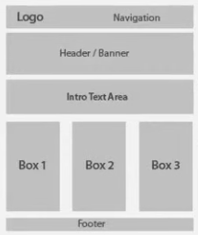
Why angular?
Modularity
Consistancy
Maintainability
Productivity
Early handling, suggestion of error using typescript
Better Mobile support
In angular everything is a component, gives better code reuse
Cross plateform, SPA application
Angular is component based framework, and components are resuable

Slide 7
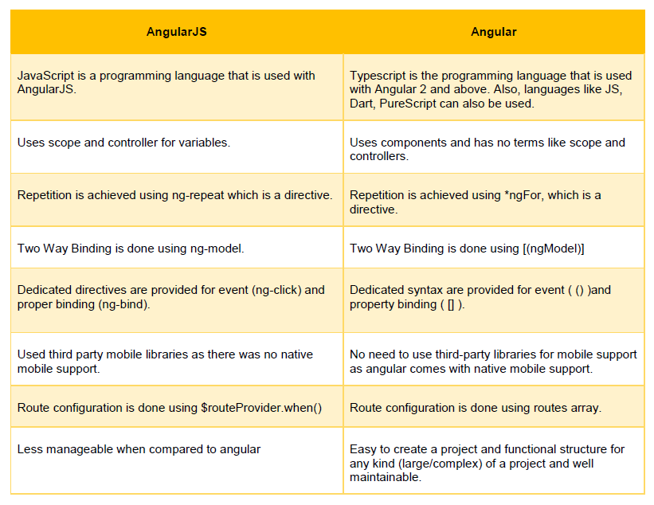

Slide 8
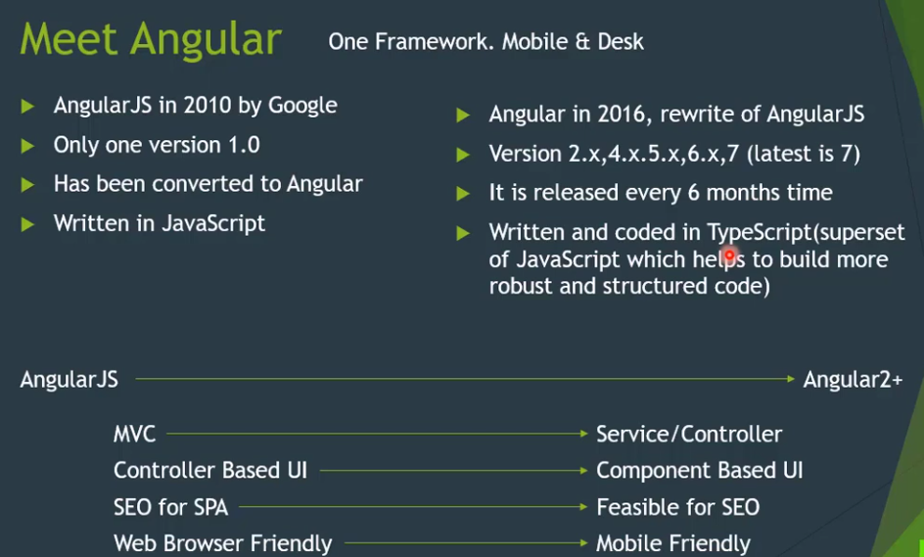

Slide 9
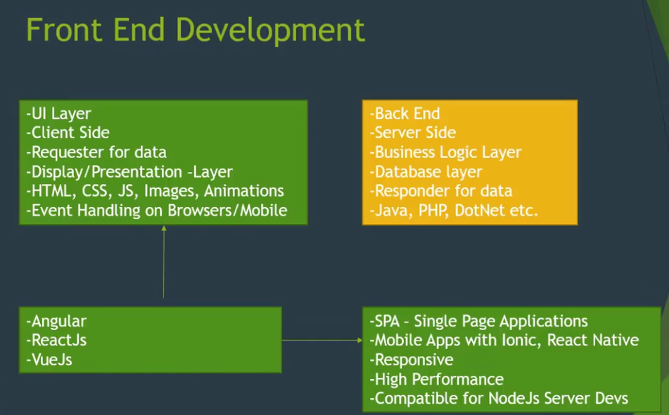

Slide 10
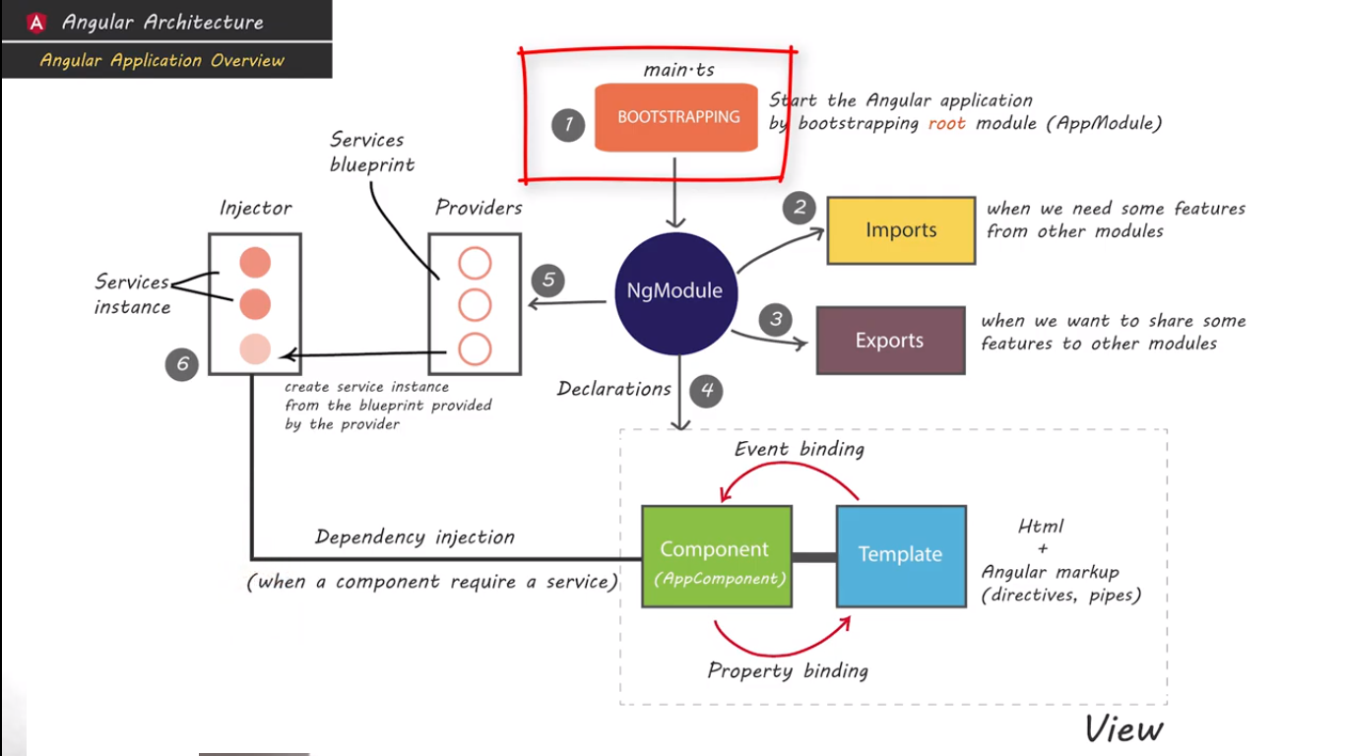
Angular Architecture

Slide 11
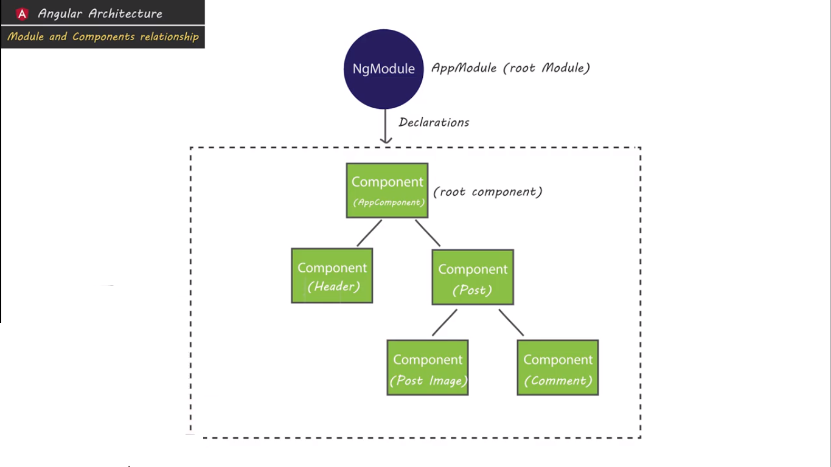
Module and component intraction

Slide 12
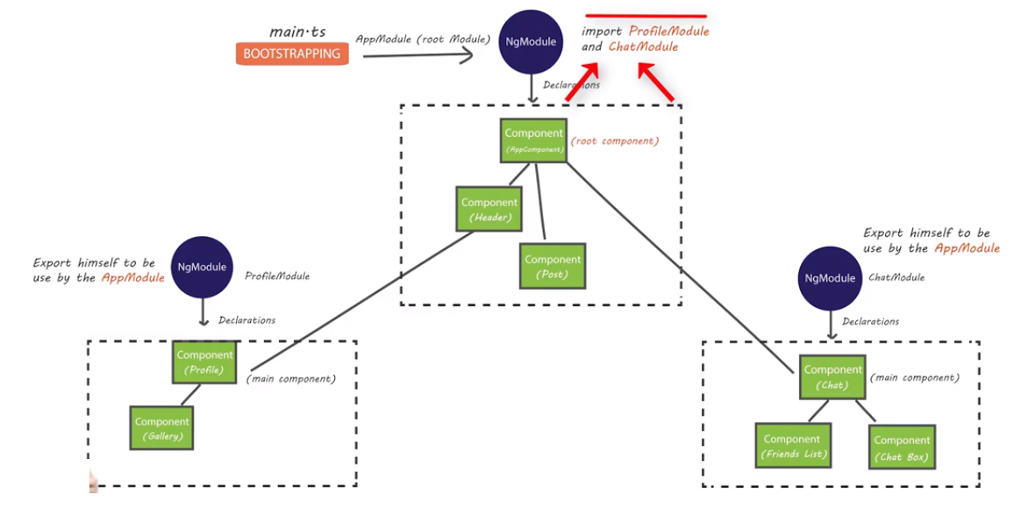
Angular modules intraction

Slide 13
Angular 8 hello world

Slide 14
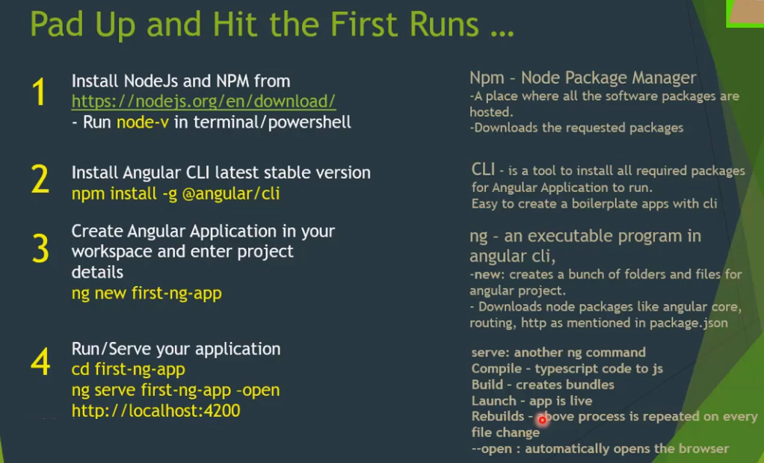

Slide 15
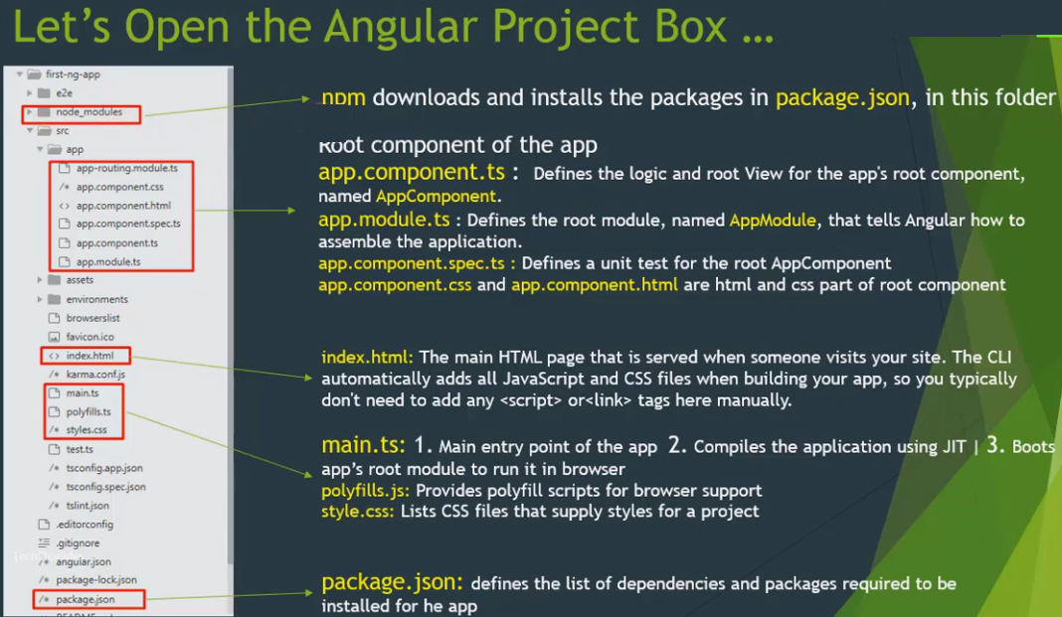

Slide 16
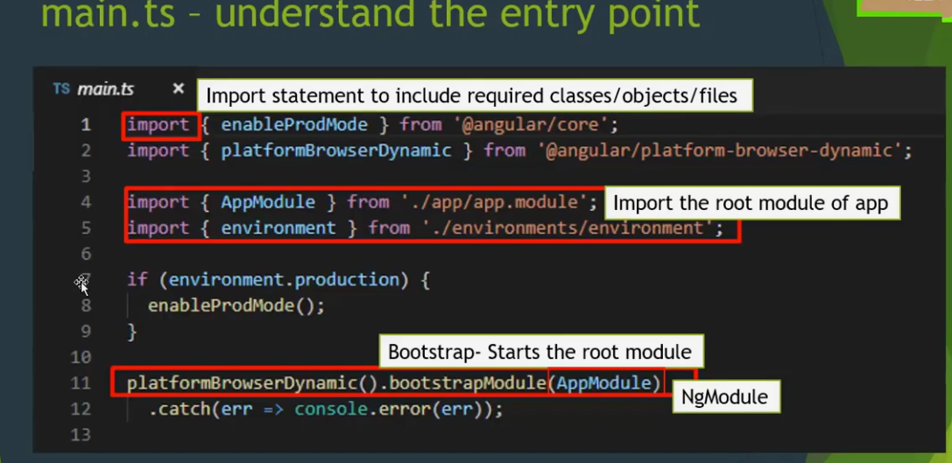

Slide 17
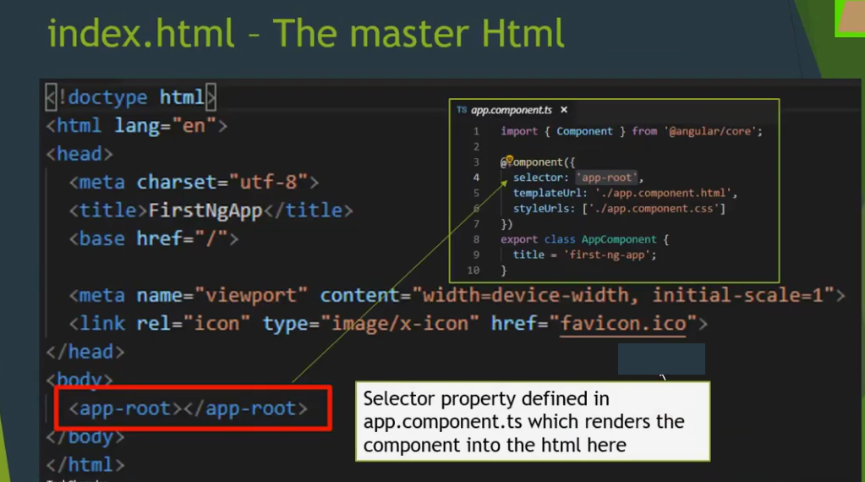

Slide 18
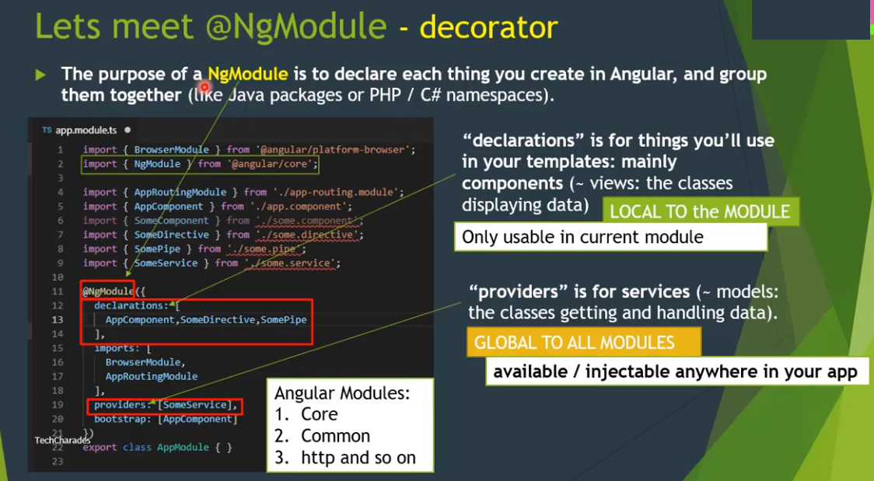

Slide 19
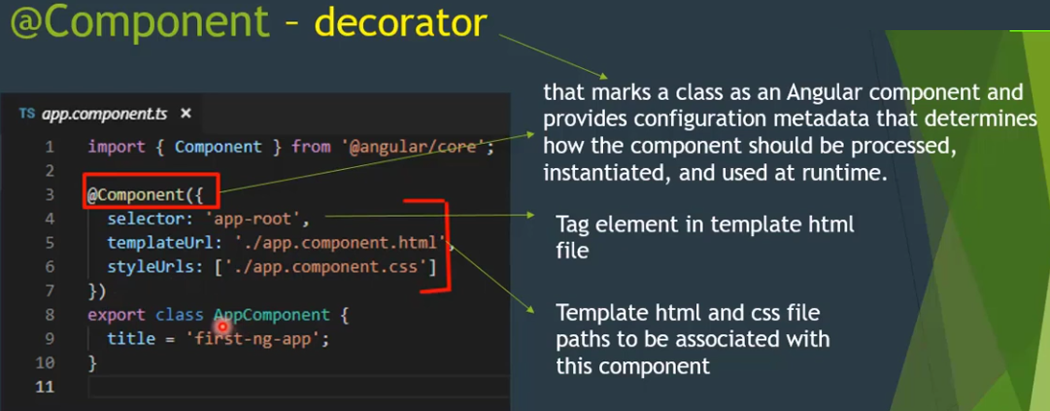

Slide 20
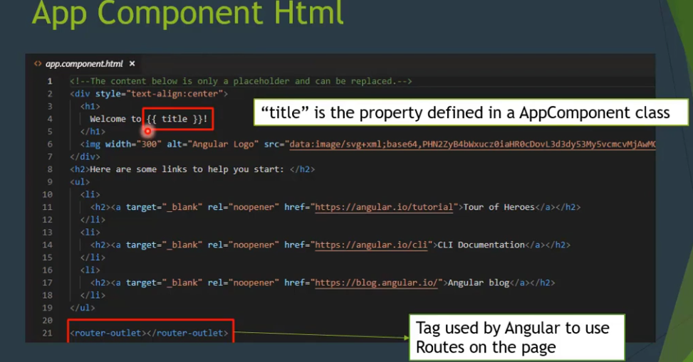

Slide 21
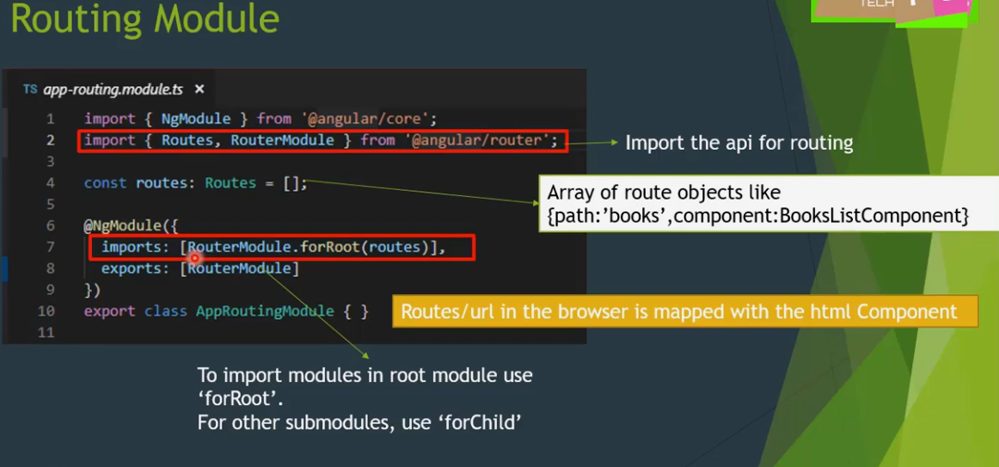

Slide 22
Angular module

Slide 23
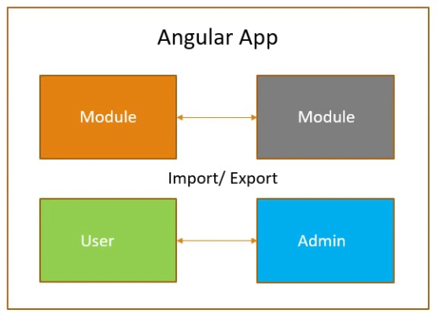
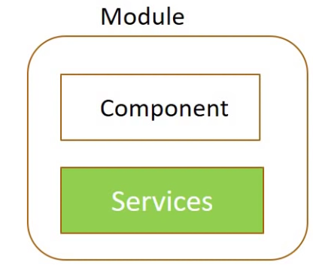
module
Angular app is modular in nature
Module hold other components.
Every angular project must have at least one module ie root module called AppModule
Each module consist of components and services, pipes etc

Slide 24
Angular components

Slide 25
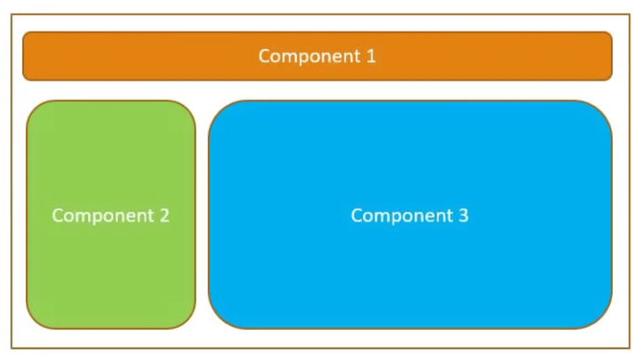
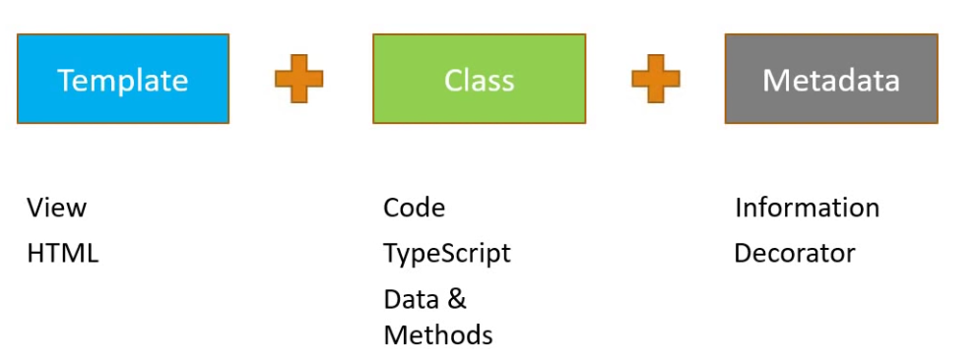
Angular components
Components are the most basics building
block of UI in angular application
An component must belong to ngModule
A component is a class with Decorators

Slide 26
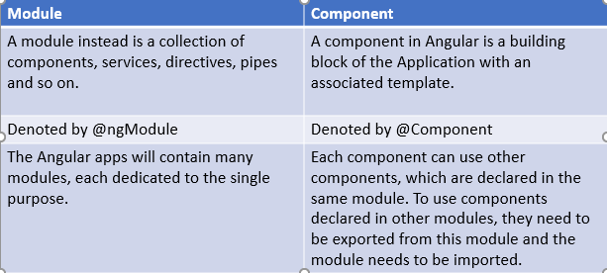
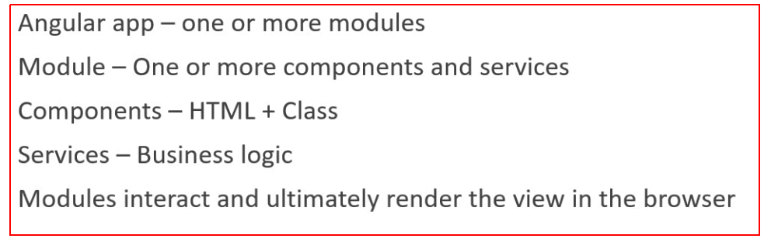

Slide 27
Angular Interpolation

Slide 28
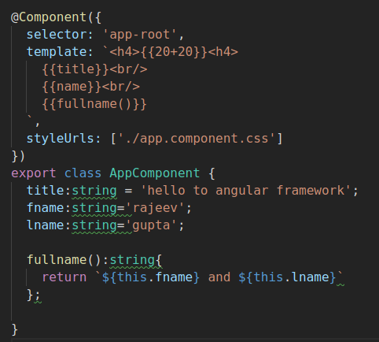

Angular Interpolation
Interpolation use template expression in {{ }} curly braces to display data from component class and template reference variable
It contain templete expression that allow us to read primitive or object or functions return value from component properties

Slide 29
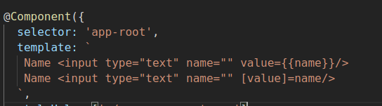
Property binding
We can use {{}} or property binding [value]=name for one way binding
Component --> view one way
Difference:
  Interpolation is an alternative of Property binding only work for string (not for boolean etc:, hence property binding is better
  Ex:

Slide 30
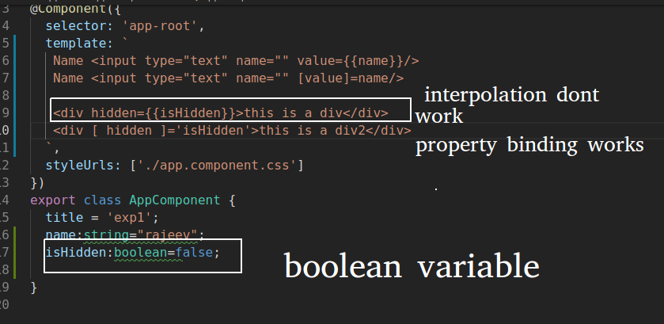
Property binding vs Interpolation

Slide 31
Event binding in Angular

Slide 32
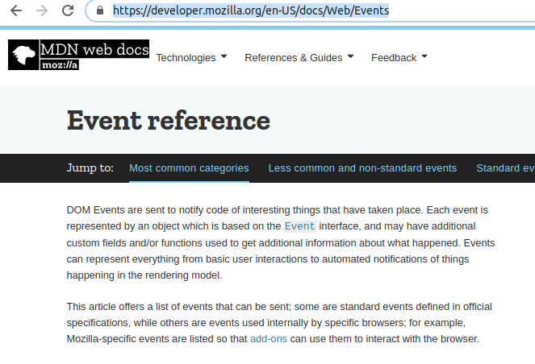
Event binding in Angular
Handling to user input events using component class is called event handling
Envents supported in angular are enclosed in parenthesis ()
  https://developer.mozilla.org/en-US/docs/Web/Events

Slide 33
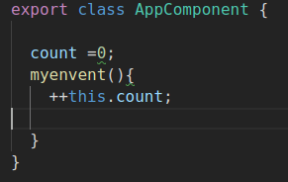
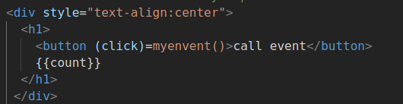
Event binding in Angular
How to handle DOM events?
How to use $event object?
  $event is object to get information from view related to DOM in component class

Slide 34
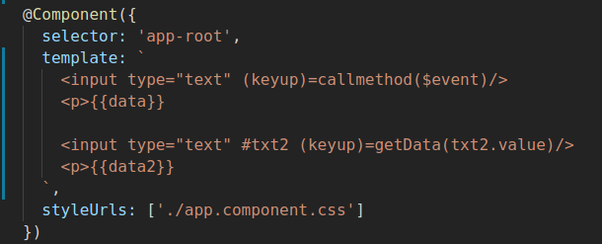
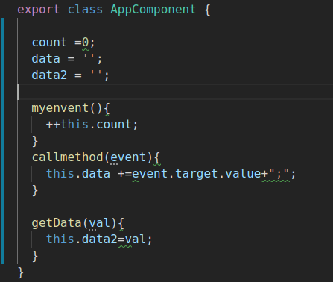
$event object

Slide 35
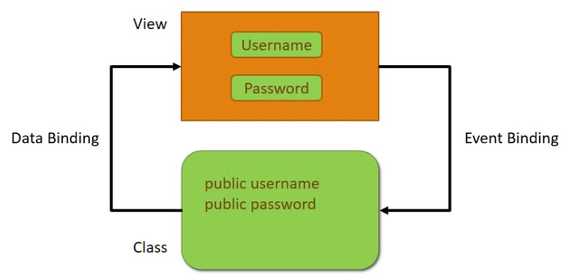
2 Way data binding Angular

Slide 36
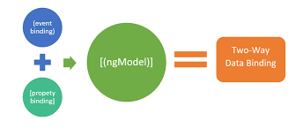
Type of databinding
No binding
  <input name=”fname”/>
One way
  <input name=”fname” [ngModel]=”fname”/>
Two way
  <input name=”fname” [ngModel]=”fname” (ngModelChange)=”fname=$event”/>
  <input name=”fname” [(ngModel)]=”fname”/>

Slide 37
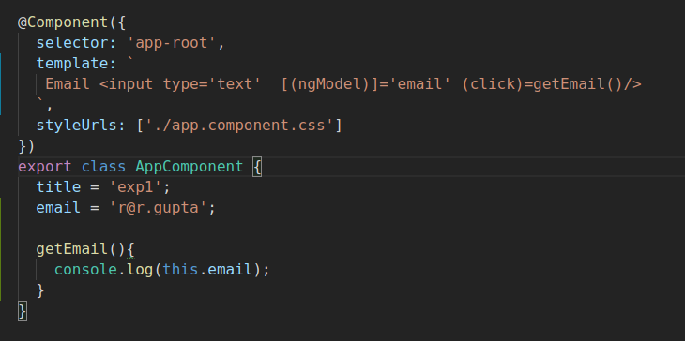
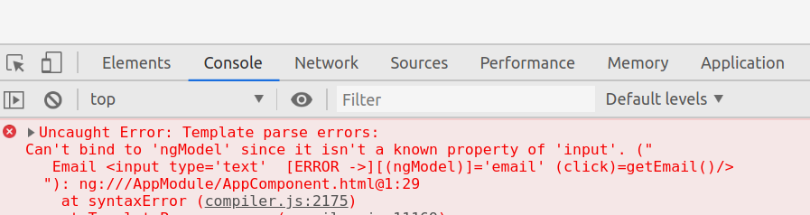
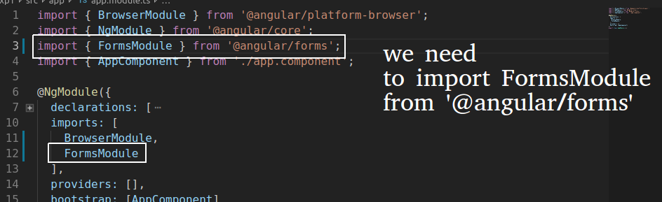

Slide 38
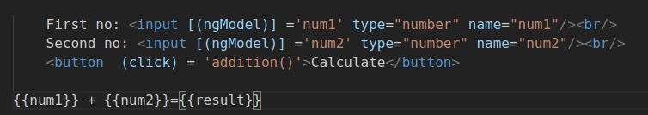
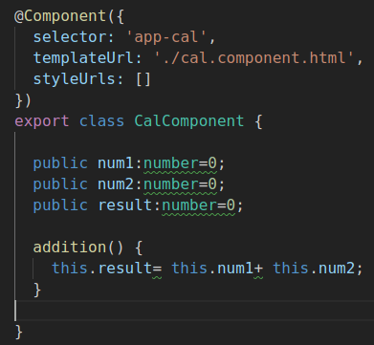
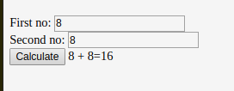
Calculator Example

Slide 39
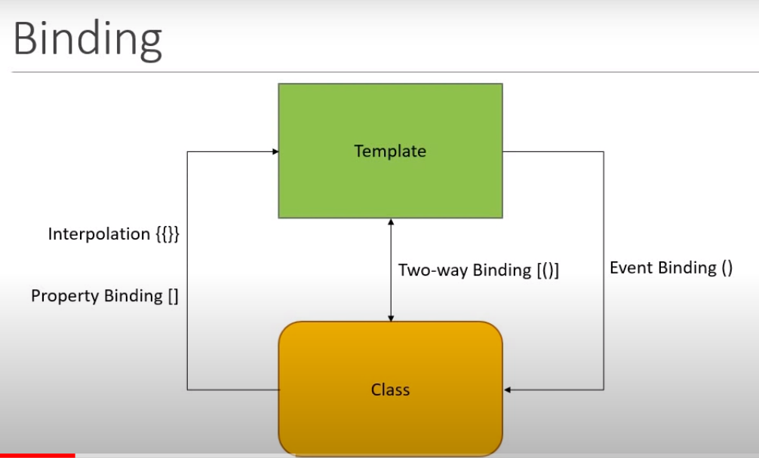

Slide 40
Component communication

Slide 41
Component communication
Parent to child communication
  How a child component can send data to the parent component.
  using @Input decorator,It is used to Passing data from parent to child comp
  it is done using property binding

Slide 42
Component communication
Child to Parent communication
  @Output() Decorator is used to pass data from child to parent via event
  it is done using event

Slide 43
Intermodule communication
Create new module that is required by app.module ng g m mod1
Create a component in that module ng g c mod1/comp1
Import mod1 to app.module
Ask mod1 to exports comp1

Slide 44
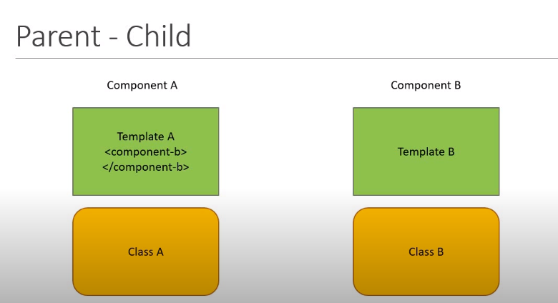

Slide 45
Directives

Slide 46
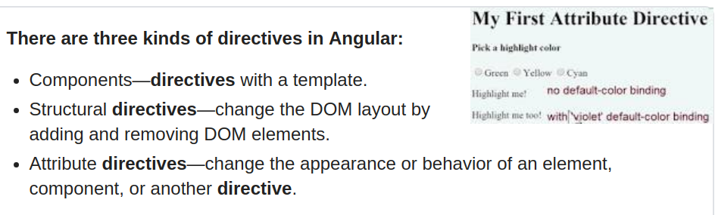
Directives
Directives are instructions in the DOM.
They specify how to place your components and business logic in the Angular.
You can define your own directives to attach custom behavior to elements in the DOMa

Slide 47
Structural directives
Add or remove html elements
  ngIf
  ngSwitch
  ngFor

Slide 48
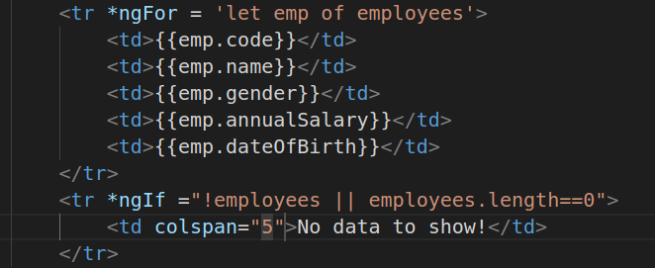

Slide 49
Pipes in angular

Slide 50
Pipes in angular
A pipe is used to format the value of an expression displayed in the view
Angular comes with multiple predefined pipes such as date curreny, lowercase, upper case and others
  Syntex :{{expression | pipeName:inputParam1}}
If pipe takes multipe inputs then they can be placced one after another separated by a colon :
  Ex: {{fullname | slice:0:20}}
pipes can be chained, ie output from one pipe can serve as the input to another pipe
Common pipes:
  date: date filter is used to formate the date in a specified manner
  uppercase and lowercase: chagne the case of input string
  decimal and percent: based on current brower locale
  currency: used to format numeric values as a currency based on the current brower locale
  {{14.22 | currency:"USD"}} {{14.2 |currency:"USD":true}}
  json: handy pipe that convert any input into a json string using JSON.stringify

Slide 51
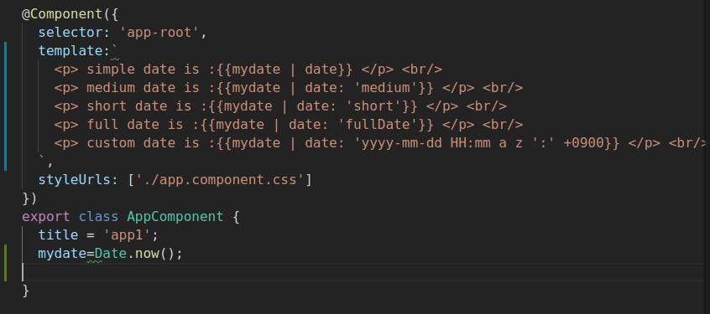

Slide 52
Decimal pipe
This pipe is uesd for transformation of decimal numbers
The first arguement is a formate string of the form
  "{minIntegerDigits}.{minFractionDigits}{maxFractionDigits}"
  Ex: {{2.24159265 | number: '3.1-2'}} Output: 002.24
  Ex: {{3.15159265 | number: '1.4-4'}} Output: 3.1416

Slide 53
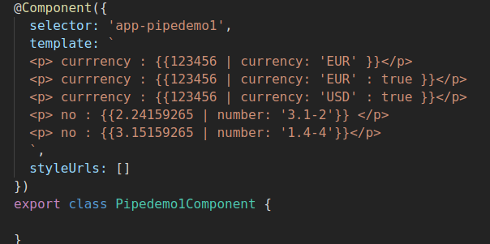

Slide 54
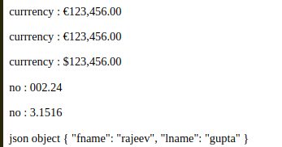
JsonPipe
This transforms a javascript object into a JSON string
  object : Object ={fname:'rajeev',lname:'gupta'};
  <p> json objet: {{object | json }} </p>

Slide 55
Custom pipe
The pipe is a class that contain "pipe" metadata
The pipe class contains method "transform", which is implememented from "PipeTransform" interface. This method accepts the value and optionally accept the arguments and convert it to the required formate
we can add the required argument to the "transform" method
The @pipe decorator is used to declare pipe and it is defined in core angular library, we we need to import this library. This decorator allow us to define the name of the pipe, which is used in html markup
The 'transform' method can return any type of value.
If our pipe's return type is decided on run time, we can use 'any' otherwise we can defind specific type such as number or string

Slide 56

How to define custom pipe?

Slide 57

Using custom pipe

Slide 58
Angular services

Slide 59

Angular services
Let say we need to print emp names on ui

Slide 60

Angular services
Let say now we need to display whole employee details

Slide 61


Angular services
We are doing copy paste of employee data in both component, that is not good.

Slide 62

Angular service
Problem with previous code is that employee array is local to both component
Service is a class a specific classs with specific purpose, service can provide data to components
We put application logic to angular service layer
We want to seprate concern of component and service layer

Slide 63


Dependency Injection
Code without DI
  Any time Engine, Tires class changes we need to change Car class
  Testing is difficult if we want to chane the type of Engine and Tires
  DI help us to solve this problem

Slide 64


Dependency Injection

Slide 65



Slide 66



Slide 67
Angular DI
Angular DI uses an concept called injector where it register all dependencies, framework manages all dependencies
We register all services EmployeeComponent may depends such as Service1, Service2 etc, with injector, now when we initilize EmployeeComponent injetor provide(inject) all dependencies to EmployeeComponent

Slide 68

Steps for Defining Services

Slide 69


Step 1: Define EmployeeService
Create a service that return hardcoded Employees data
@Injectable() annotation tell that this servie is injectable, it can further have injected services
Create an empty array in EmployeeDetailsComponent to accept the data form the service

Slide 70

Step 2: Register with Injector
We need to register our service with the angular injector, if we dont register then service is only a simple class and DI dont work
It is better if we register service with AppModule so that all compnents can access it.

Slide 71


Step 2: Register with Injector
Register in app.module.js

Slide 72

Step 3: Declare as DI in Employee component
Inject service EmployeeService to EmployeeListComponent
We can inject service to any component that need that
@Component annoation tell Angular to look for dependencies and inject it if it is registered with angular.

Slide 73
HTTP and Obserable

Slide 74

HTTP mechanism

Slide 75
HTTP mechanism
Http mechanism consist of two steps:
  First step: Send the http request
  Second Step: Recieve and process http response
  What is Obserable?

Slide 76


  Obserable

Slide 77
  Obserable
Obserable is simply http response obtained from REST api
Obserable is not the formate that is used by component, so we need to convert data into employee Array
Data is provided to only component that subscribted to it.
Now it is upto component to display data however they want

Slide 78

  Http, Obserable, RxJS

Slide 79
Routing in angular

Slide 80

What is routing?
web applications can have different sections that corrosponds to different URLs and supporting those section programmatically is called routing
In simple words, as per url open different angular components is called routing

Slide 81

Steps for routing

Slide 82

CanActivate route guards

Slide 83

CanActivate route guards

Slide 84

Angular forms

Slide 85

Angular forms
Angular offers two types of forms:-
  template-driven
  model-driven

Slide 86
Template Driven
template-driven forms place the emphasis on developing a form within an HTML template and handling most of the logic for the form-inputs, data validation, saving, and updating-in form directives placed within that template.
Very less code required because most of the forms related work have been done by the angular framework itself.
heavy use of the ngModel form directive
FormModule must be imported into app-module.ts

Slide 87
Directives for form building
NgForm
NgModel
ngForm:
  It plays a great role in form building, this angular directive concrete values of all HTML elements of form.
  We can say that by using this directive we are capable to create form object.
NgModel
  This directive has used for binding, one-way and two-way data binding.
  It is responsible to hold values of HTML elements.
  It is also used to validate HTML elements values.

Slide 88


